Slide 1
Final Presentation Team Black
Bühler Ueli, Jahn Tim Allan, Kandiah Rajilatha,
Klembowski Raphael, Ristic Nikola, Sutter Christoph

Slide 2
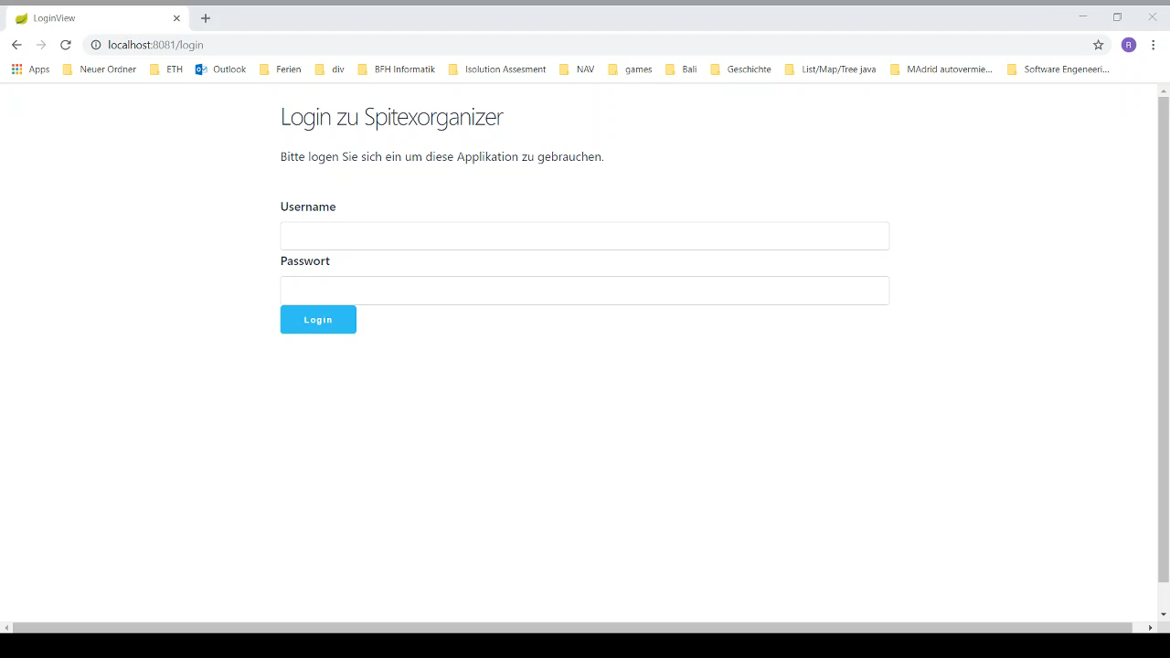
Screencast

Slide 3
features implemented vs. design thinking ideas
features implemented vs. design thinking ideas
All features included
Prototyps don’t look like final Version

Slide 4
architecture & coding highlights
Spring
Hibernate
MVP
H2

Slide 5
list of personal contribution for each team member
Ueli
Project Setup
Diagrams
Documentation
Rajilatha
Docoumentation
DB Setup
Raphael
Documentation
Evaluation List
Christoph
Documentation
Evaluation Detail
Nikola
Report List
Documentation
Tim
Documentation
Login

Slide 6
Scrum Retrospective
Good:
Teamwork, even though it was a big team
Everyone learned something
Cool experience to create something from ground up
Bad:
Vaadin Documentation
Git Introduction
Improve:
Layout
Not everything was thought out during the planing phase

